Slide 1
Health Awareness and Nutrition
Minerals and Water
Department of Clinical Nutrition and Dietetics College of Health Sciences

Slide 2

Minerals
and Water

Slide 3
Introduction
Twenty two (22) minerals of inorganic nature.
General functions:
Essential for optimal health and development
Required for growth, repair & regulation of vital body functions
Represent 4 to 5% of body weight (Ca is 50% of this %)
Absorption depends on:
Their form: plant minerals are in general less efficiently absorbed than animal minerals
The body need: absorption is increased in deficiency, pregnancy & lactation
The presence or absence of other foods in intestines: which favor or inhibit the absorption

Slide 4
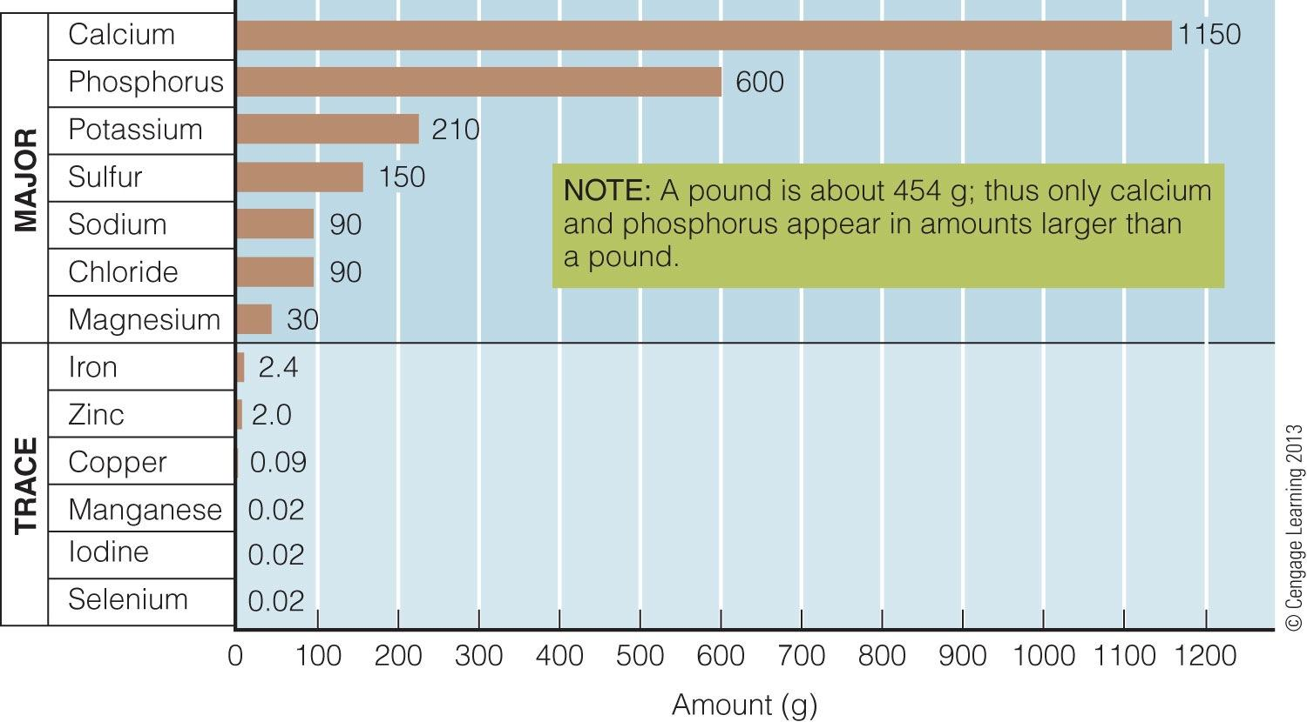
Minerals in a 60-Kilogram Human Body

Slide 5
Classification of minerals
Minerals are classified according to their amount in the body
Major minerals
Trace minerals
Found in the human body in amounts larger than 5 grams
Found in the human body in amounts less than 5 g
→ There are also the trace Contaminants: Lead, Mercury, Boron, Barium, Aluminum

Slide 6
Classification of minerals
Major minerals
> 5 g
Trace minerals
< 5 g
Calcium (Ca)
Iron (Fe)
Phosphorus (P)
Magnesium (Mg)
Sulfur (S)
Sodium (Na)
Potassium (K)
Chloride (Cl)
Zinc (Zn)
Iodine (I)
Fluoride (F)
Selenium (Se)
Cobalt
Manganese
Molybdenum
Chromium
Copper

Slide 7
Minerals
Absorption
Excess fiber intake interferes with the absorption of minerals during the same meal
Supplements
Minerals should not be taken as supplements without prescriptions, since excessive amounts may be toxic to health

Slide 8
Major minerals

Slide 9
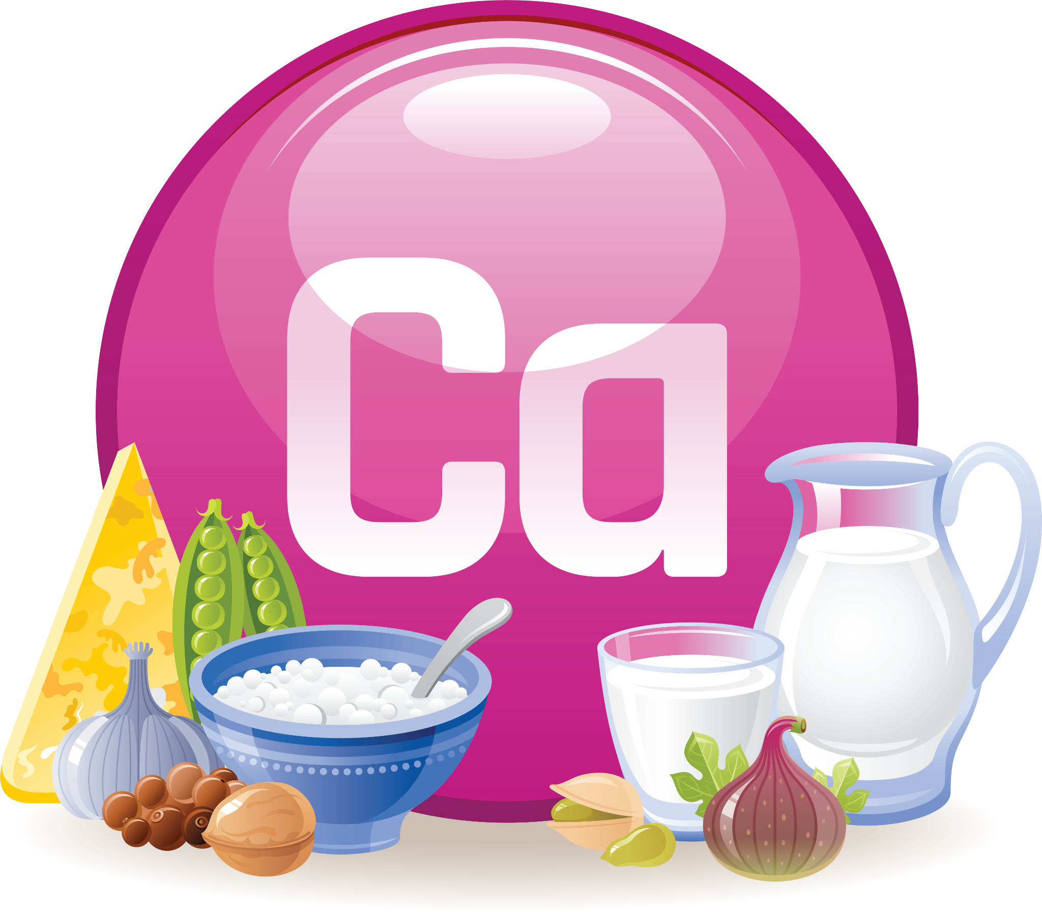
Calcium
Calcium is the most abundant mineral in the body.
Calcium and phosphorus are needed for bone formation.
Nearly all of the body’s calcium (99%) is stored in the bone and teeth.
Mineralization of bones and teeth
Involved in muscle contraction and relaxation
Bones serve as a bank that releases calcium in the blood when needed and absorbs it when in excess
Function

Slide 10
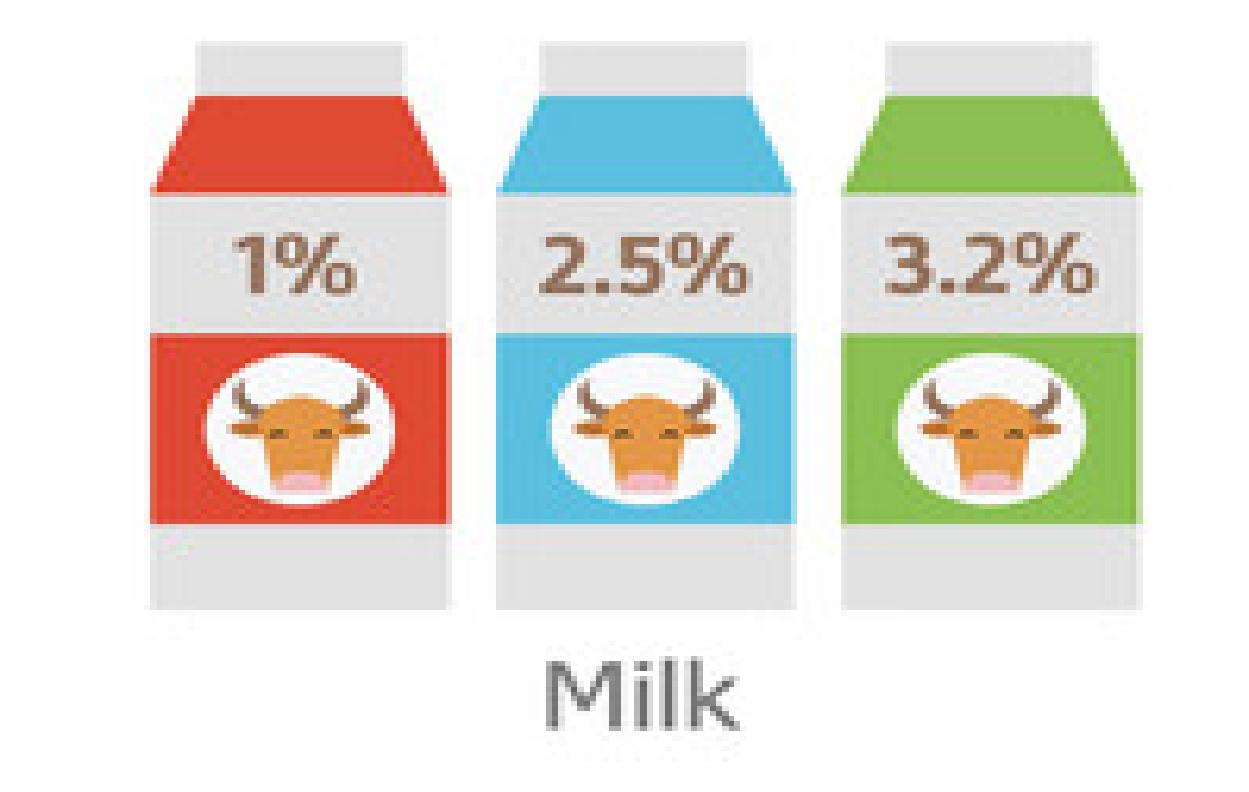

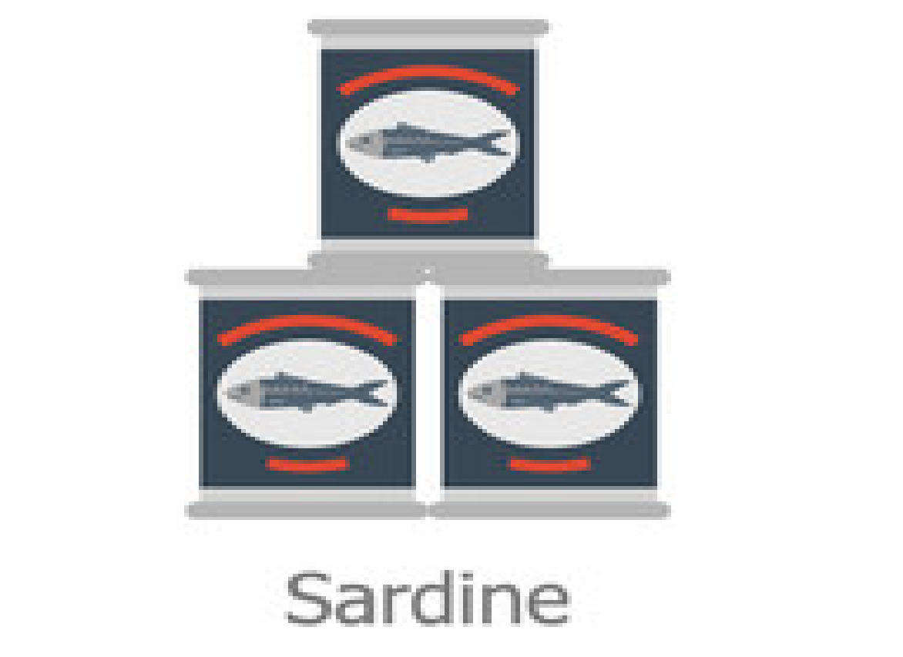

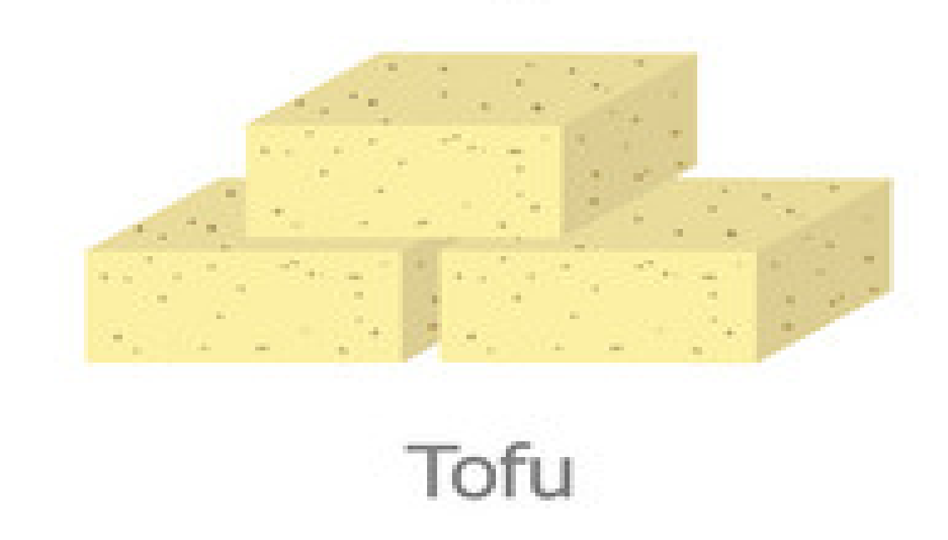

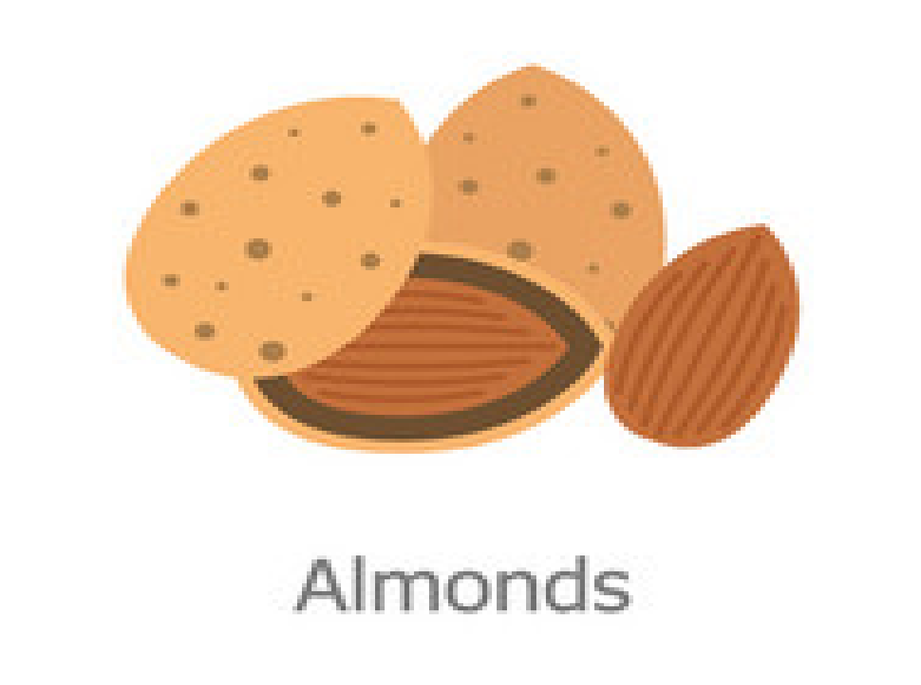

Calcium
Milk and milk products
Tofu (soybeans)
Small fish (with bones) such as sardines
Nuts (almonds)
Green leafy vegetables (broccoli, kale, seaweed)
Sources

Slide 11
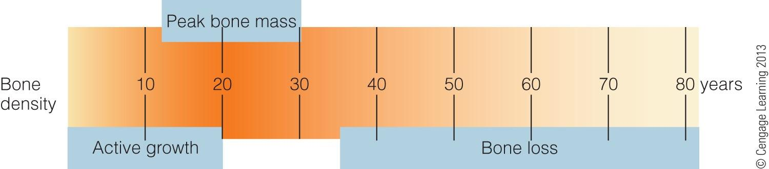
Calcium
Physiological Facts
Peak bone mass is the highest attainable bone density for an individual developed during the first 30 years of age.
All adults lose bone with age.
Bone loss begins between 30 and 40 years of age.

Slide 12
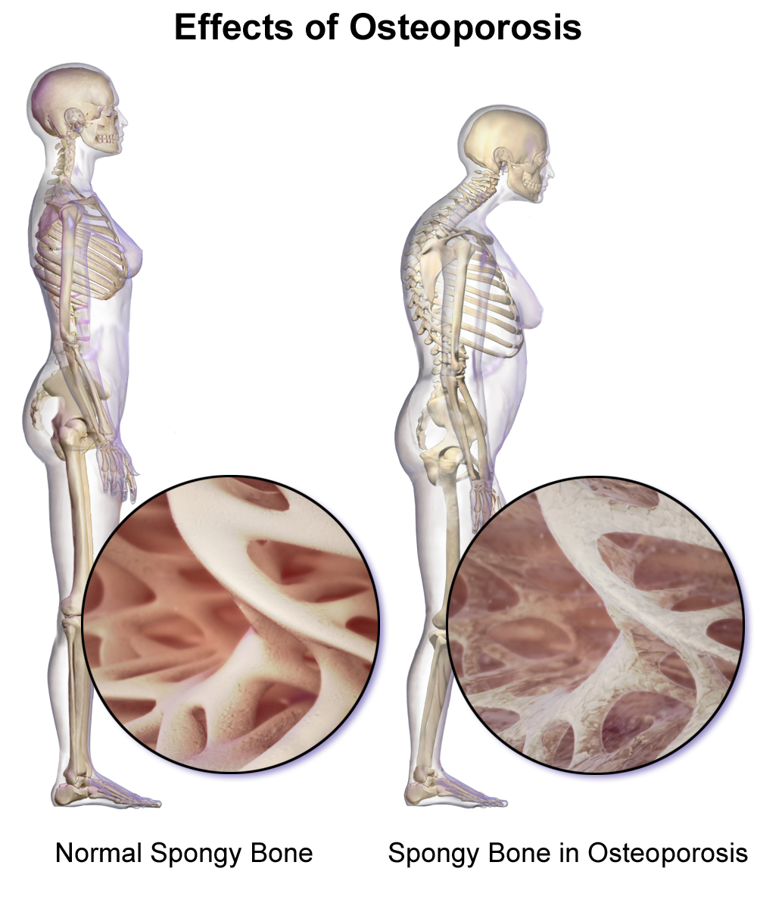
Calcium
Deficiency
Deficiency disease: Osteoporosis
Wide spread (mainly in women)
Osteoporosis, or adult bone loss, occurs if a person’s stored calcium is not sufficient.
A calcium-poor diet during the growing years may prevent someone from reaching peak bone mass during the first 30 years of age.

Slide 13
Dietary Prevention
Calcium supplements
A good calcium intake is essential throughout life for healthy bones
May be taken upon prescription along with vitamin D if someone’s dietary intake is low and absorption is poor
Calcium & Osteoporosis

Slide 14

Phosphorus
Phosphorus is the second most abundant mineral in the body.
85% is found combined with calcium in bones and teeth.
Mineralization of bones and teeth
Part of every cell (cell membranes)
Helps transport lipids in the blood
Assists in energy metabolism
Function

Slide 15



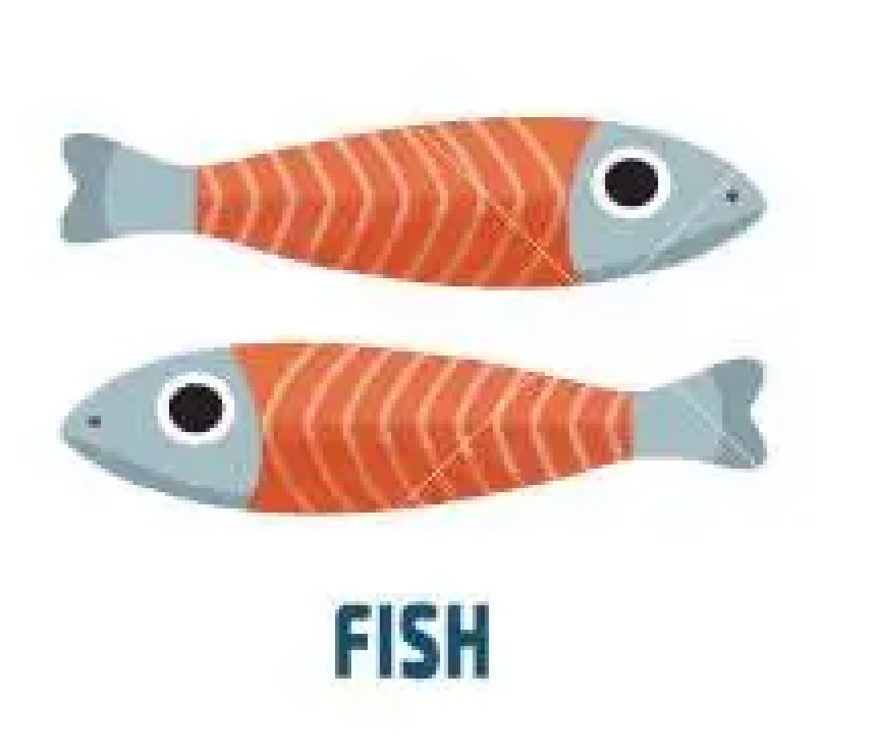

Phosphorus
All animal tissues
(meat, fish, poultry, eggs, milk)
Protein rich foods
Sources
Milk and Dairy
Meat
Poultry
Fish
Eggs

Slide 16

Magnesium
More than half of magnesium is found in bones, and the rest mostly in muscles and soft tissues.
Maintains bone health
Necessary for energy metabolism
Catalyst in ATP production
Inhibits muscle contraction and blood clotting
Supports normal function of immune system
Function

Slide 17






Magnesium
Pumpkin seed kernels
Nuts (brazil nuts, almonds, cashews)
Cacao
Spinach
Muscle spasms
Sources
Deficiency

Slide 18

Potassium
Potassium is the main mineral present inside the body’s cells (intracellular action).
Major part of fluid and electrolyte balance.
Helps maintain fluid and electrolyte balance
Helps maintain cell integrity
Aids in nerve impulse transmission and muscle contraction
Function

Slide 19
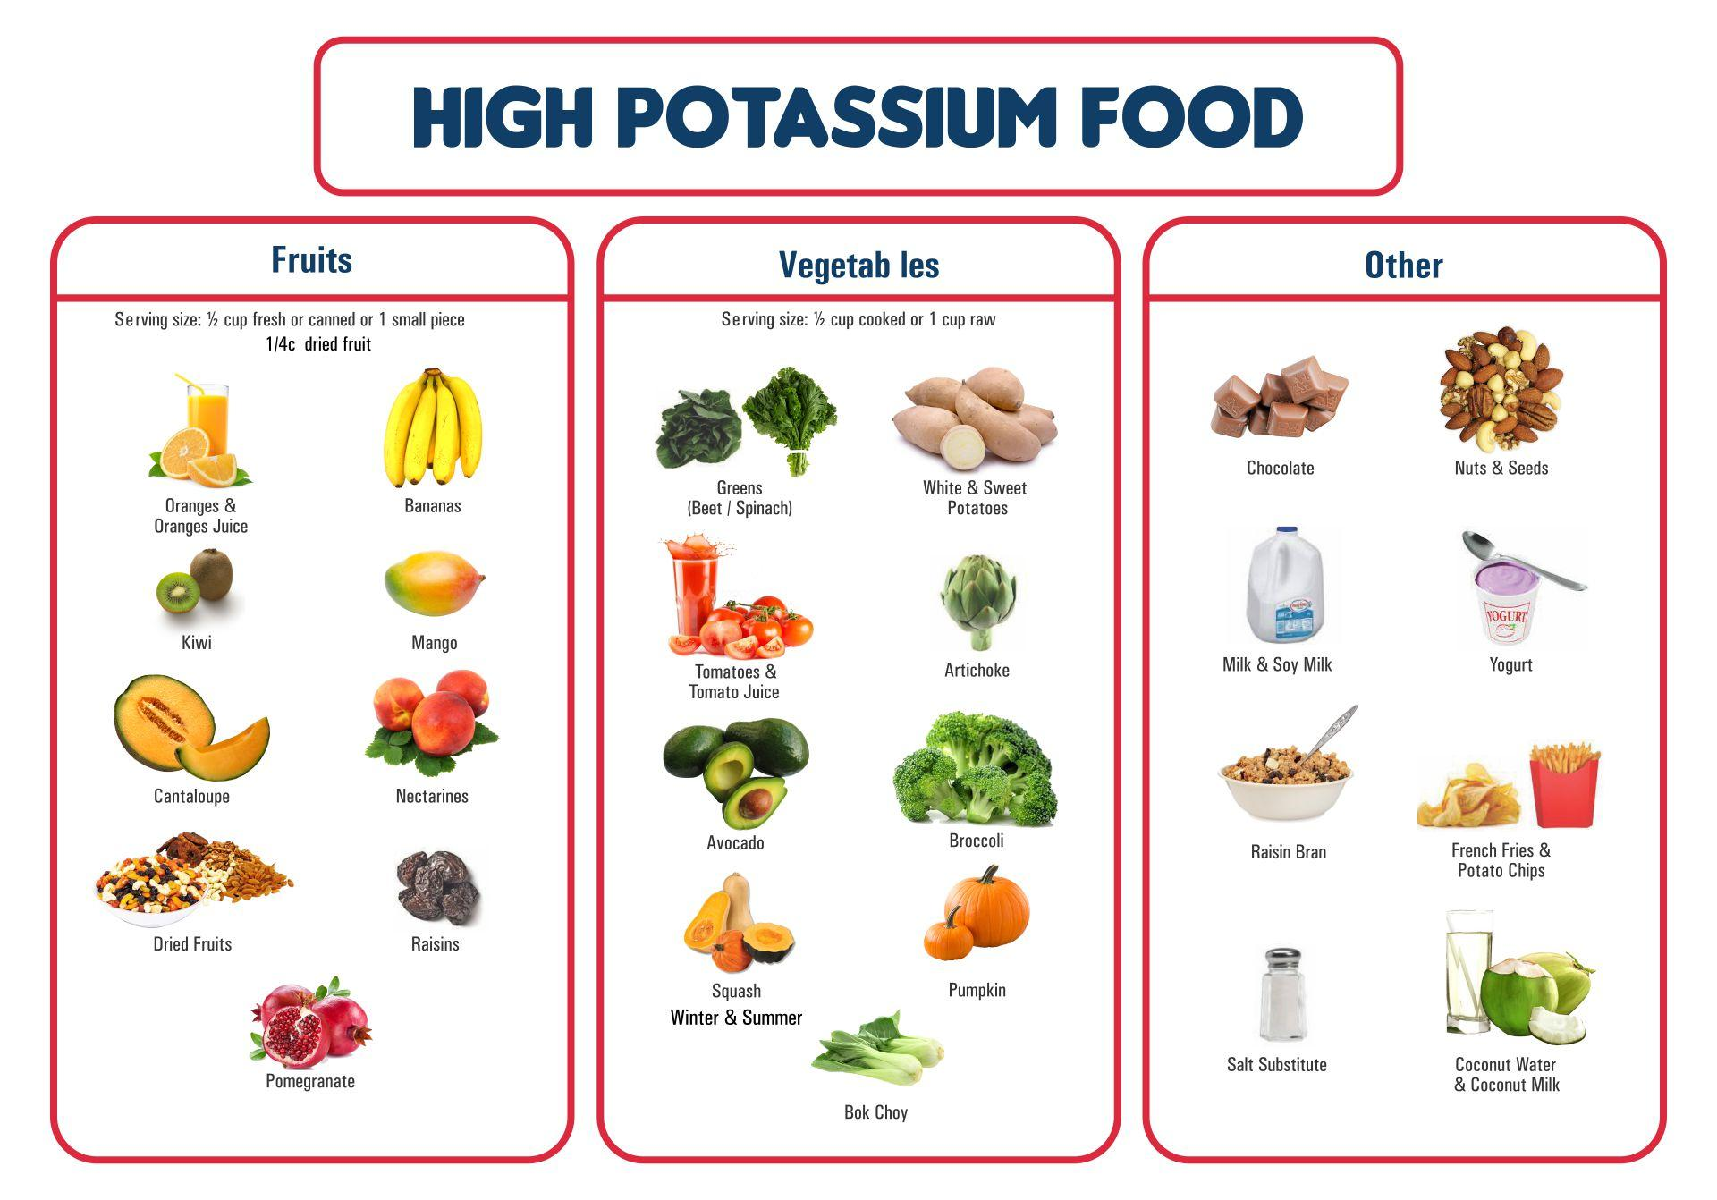
Potassium
Fresh foods
All whole foods: meats, milks, fruits, vegetables, grains, legumes
Irregular heartbeat, muscular weakness, glucose intolerance
Sources
Deficiency

Slide 20
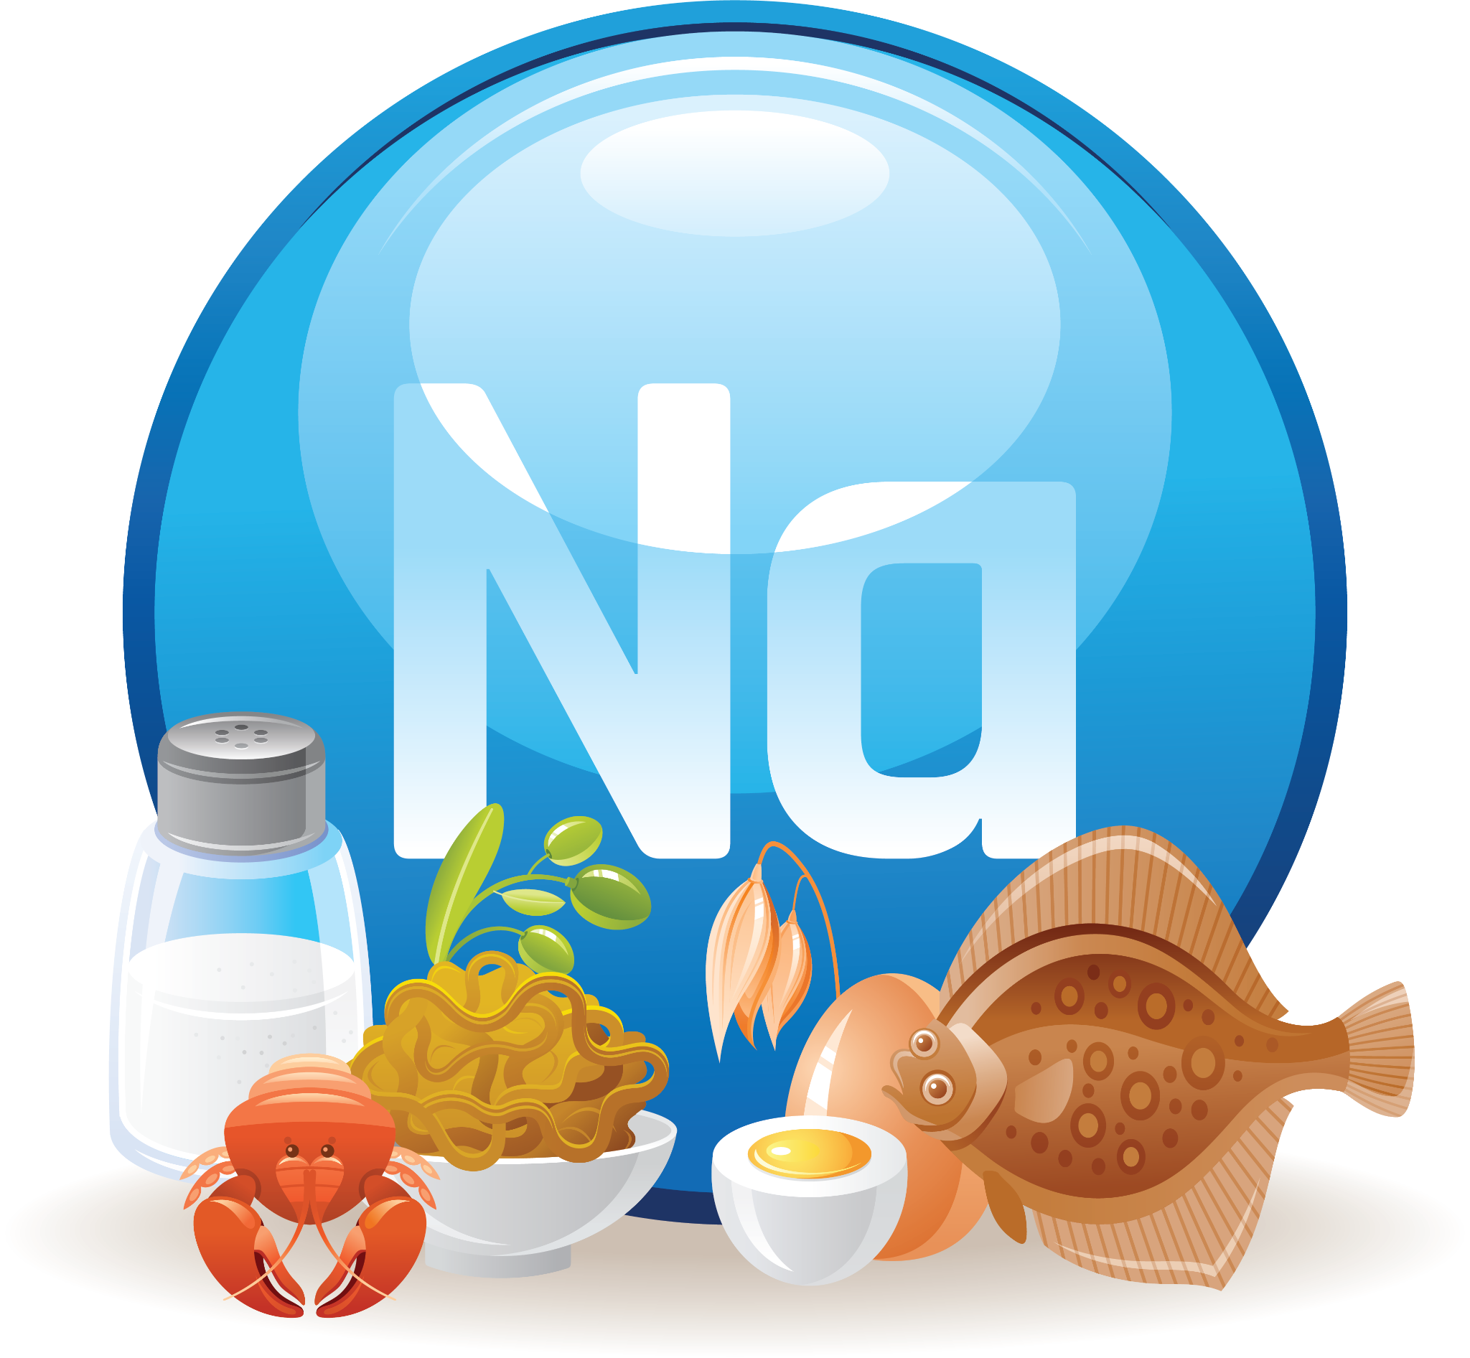
Sodium
Sodium is the main mineral present outside the body’s cells (extracellular action).
Major part of fluid and electrolyte balance.
Recommendations are less than the actual intakes.
Sodium deficiency is harmful, but few diets lack sodium.
Usually, the problem with salt is too much of it!

Slide 21
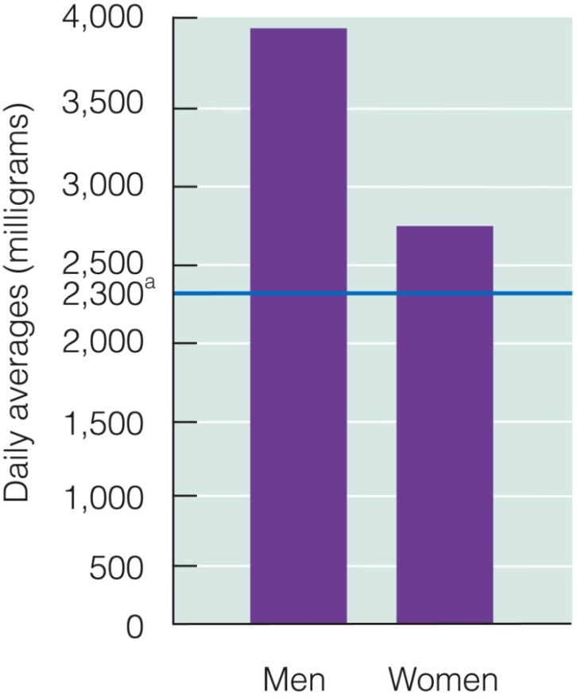
Sodium
Maintains normal fluid and electrolyte balance
Is essential to muscle contraction and nerve transmission
Function

Slide 22




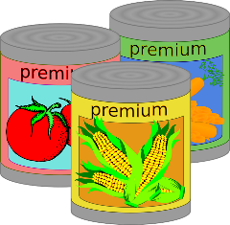
Sodium
Major source :Table salt
Large amounts in processed foods, Soy sauce
canned foods, fast foods and yellow cheeses
Moderate amounts in meats, milks and breads
Sources
Table Salt
Soy Sauce
Milk and Dairy
Fast and Processed Food
Bread
Canned Food

Slide 23
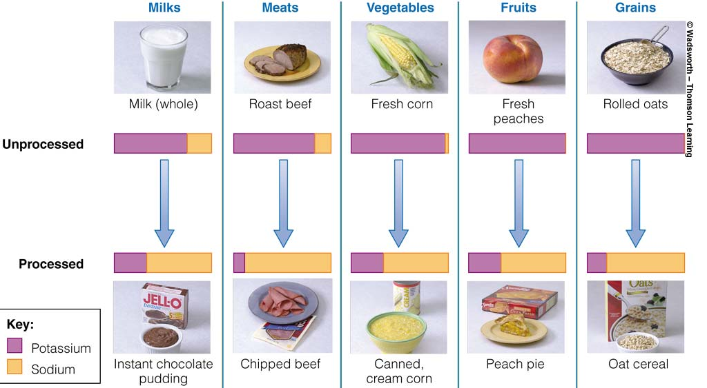
Sodium Versus Potassium In Foods

Slide 24
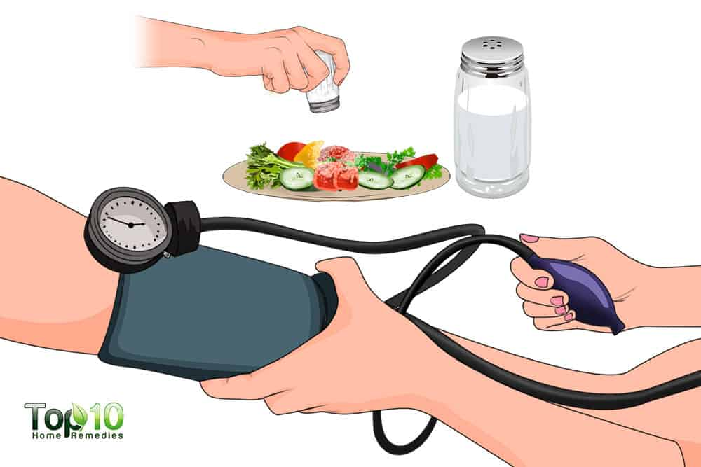
Sodium
Sodium intake increases blood pressure (for salt sensitive people).
Increased amounts of salt correlate with increased frequency of hypertension.
Toxicity

Slide 25



Three Minerals Closely Related In The Body
And Have Some Common Functions
Maintenance of water-balance: Na, K and Cl are electrolytes.
Distribution of water in the body is related to their distribution.
Assists in nerve impulse transmission and muscle contractions (heartbeat).
Sodium
Potassium
Chloride

Slide 26
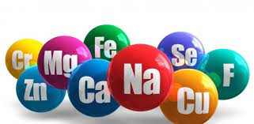
Trace Minerals
Trace Minerals

Slide 27
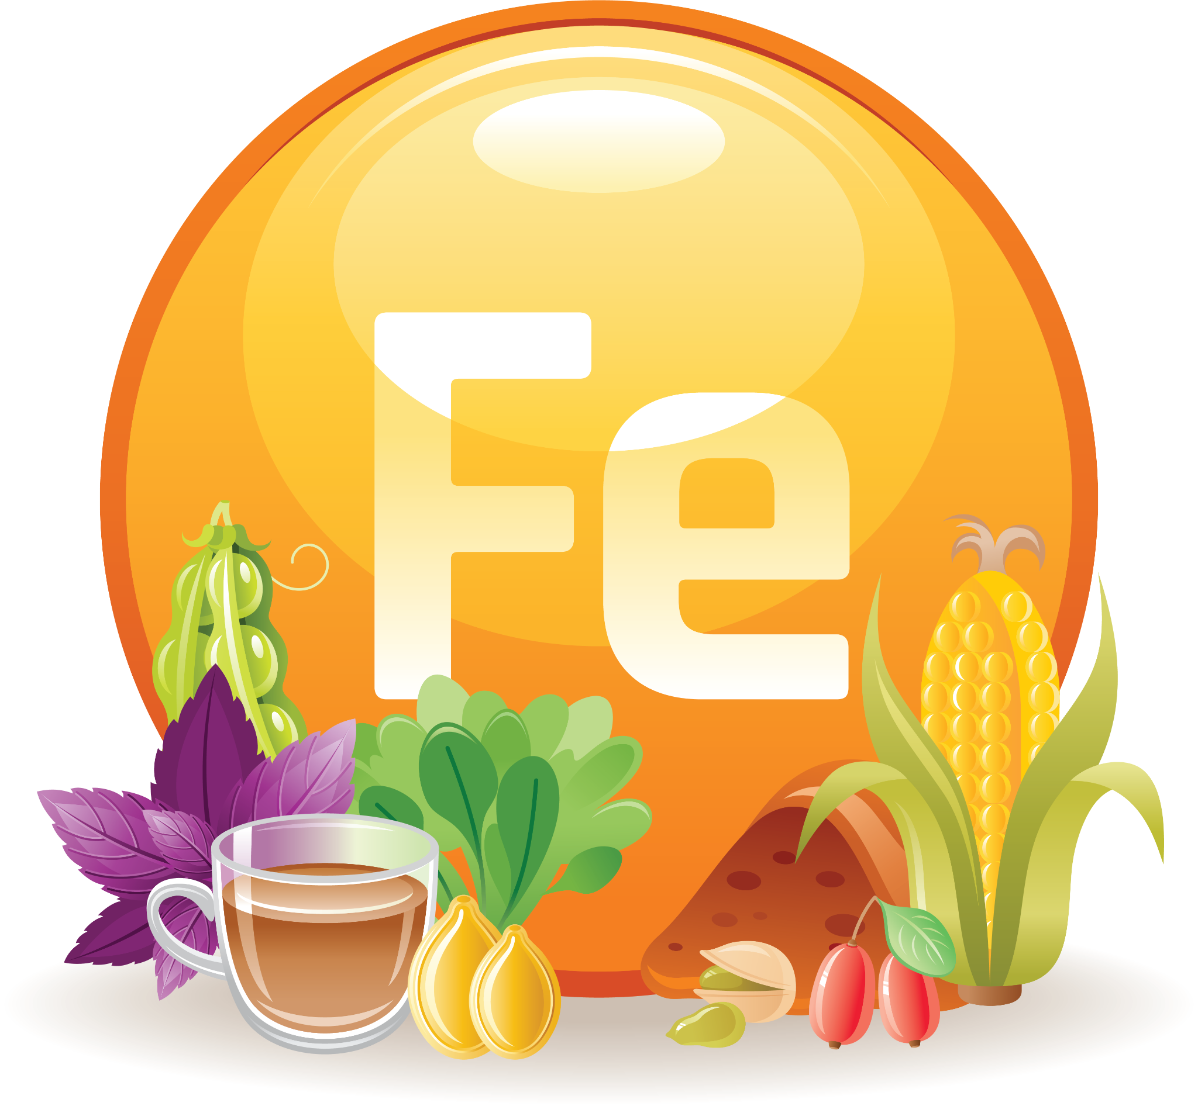
Iron
It is part of the hemoglobin (RBC) and transports oxygen to all cells
It is essential for building healthy muscles and maintaining healthy blood
Its deficiency causes anemia
Function

Slide 28

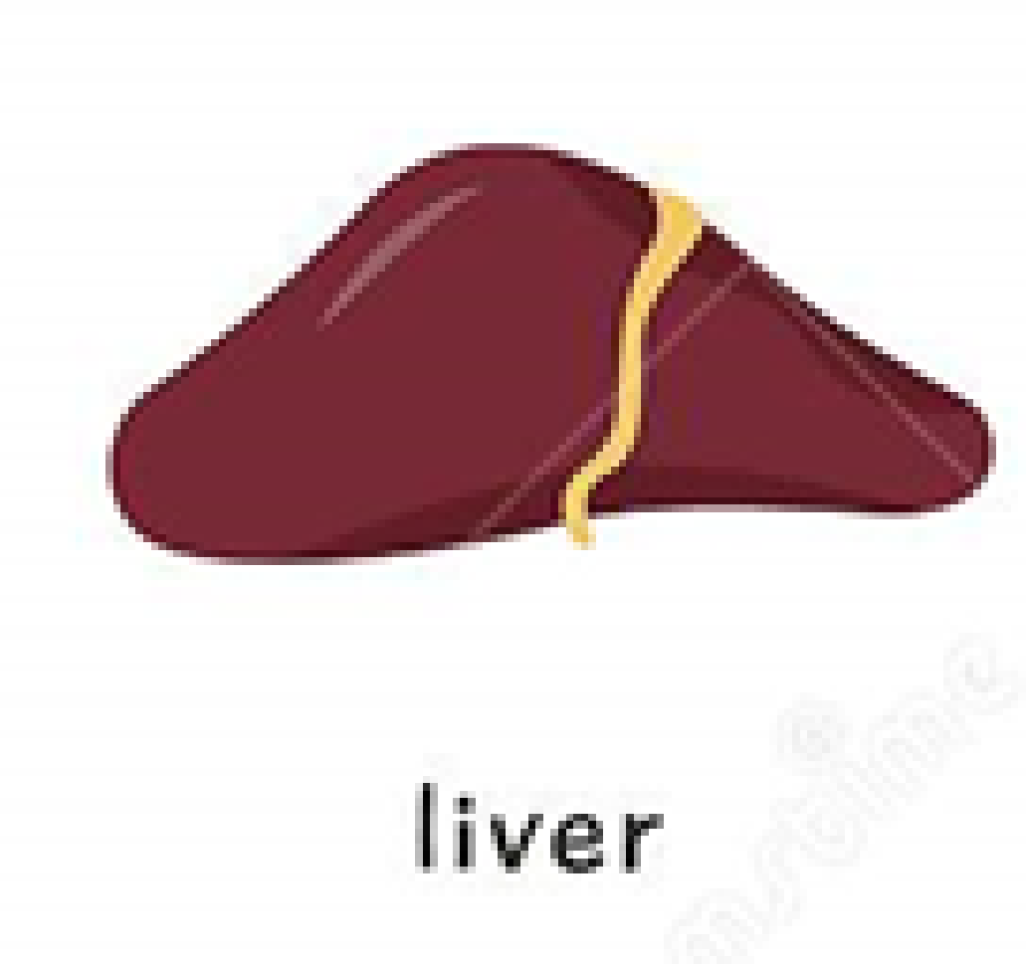



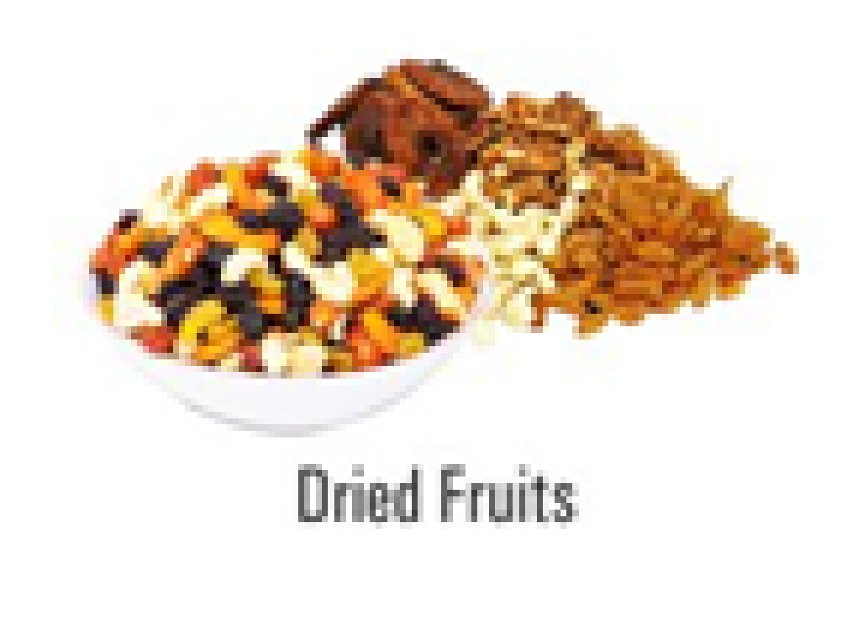
Iron
Meats (especially red meat)
Organ meat and liver
Dried fruits (raisins)
Legumes (lentils, beans)
Green leafy vegetables (spinach)
Sources

Slide 29
Iron
Heme-iron
Animal sources (beef, liver,..)
Very efficiently absorbed
Non-heme iron
Plant sources (dark green vegetables, legumes)
Animal sources
Less efficiently absorbed

Slide 30
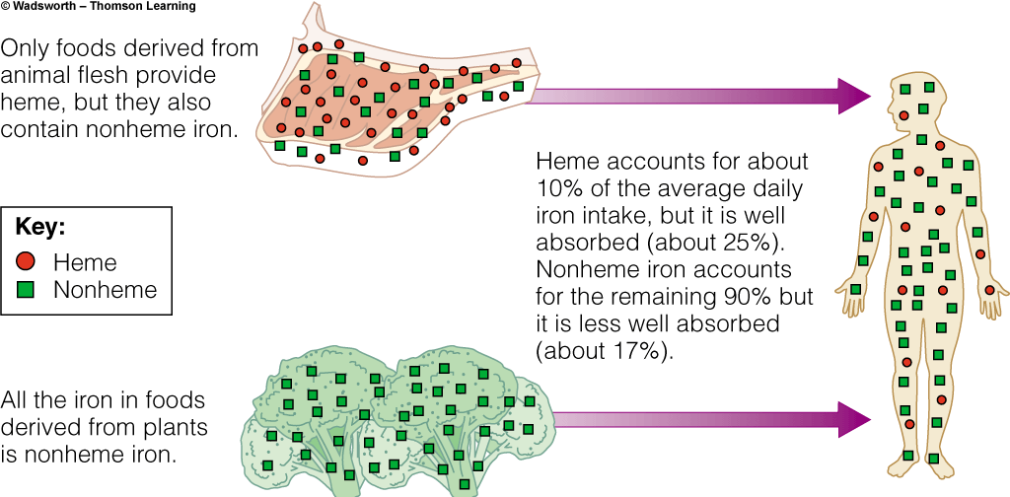
Iron

Slide 31
Iron
Enhance non-heme absorption
Animal protein
HCl (hydrochloric acid) in stomach
Vitamin C
Inhibit non-heme absorption
Phytates and oxalates (found in some vegetables)
Fibers
Tannic acid (tea, beer, soft drinks)
Other nutrients: zinc, calcium

Slide 32
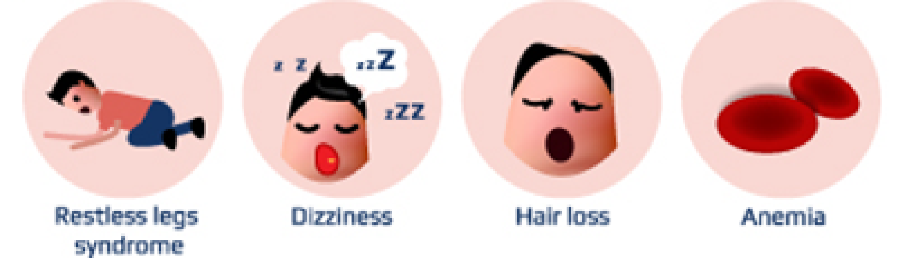
Iron
Most common nutrient deficiency worldwide.
Symptoms include: anemia, fatigue, decreased performance.
Iron deficiency anemia means anemia due to severe deficiency in iron stores.
Deficiency

Slide 33
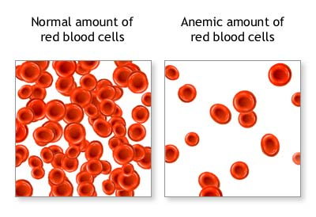
Anemia
Anemia is a condition characterized by a reduction in the hemoglobin and/or in red blood cells.
Hemoglobin (Hb) is the oxygen-carrying protein inside red blood cells. It gives the red color to blood cells.

Slide 34






Anemia
Anemia affects more than 30 percent of the world's population, it is one of the most important deficiencies in both developing and developed countries.
All age groups might be at risk.
Most affected groups:
Infants
Adolescents
Preschoolers
Pregnant women
School aged children
Elderly

Slide 35
Anemia
Main Causes of Anemia
Iron Deficiency Anemia
Megaloblastic Anemias
Deficiency of Vitamin B12 or Folate (folic acid)
Anemia of chronic disease
Malaria, Tuberculosis, HIV
Other Causes of Anemia
Excess blood loss (ex: from menstruation in women)
Ingestion of toxic (poisonous) substances, such as lead and other compounds
Genetic (heredity) abnormalities

Slide 36
Anemia
Main Causes of Anemia
Iron deficiency Anemia
Megaloblastic Anemias
Insufficient iron available for the normal production of hemoglobin
Results from an imbalance between supply of vitamins necessary for DNA synthesis
Small and pale cells are produced (Microcytic hypochromic anemia)
The cells are not matured and larger in size
Deficiency of Vitamin B12 or Folate (folic acid)

Slide 37
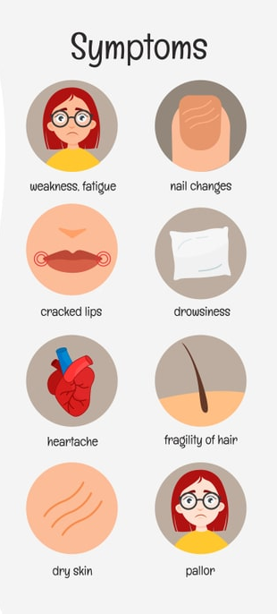
Anemia
Clinical Signs and Symptoms of Anemia
Most commonly, people with anemia report:
Feeling of weakness or fatigue in general or during exercise, general discomfort (malaise)
Poor mental concentration
Severe cases often report shortness of breath (dyspnea) on exertion, rapid heart rate (palpitations) and sweating
Pale (pallor) of skin, mucosal linings and nail beds
Cracking of lips and spoon shaped nails
Craving for consumption of non-food items (pica) such as dirt, paper, wax, grass, ice, and hair, may be a symptom of iron deficiency
Behavioral disturbances in children as a direct result of impaired neurological development in infants, and reduced scholastic performance in children of school age

Slide 38
Anemia
Decreased work capacity
Prematurity and low birth weight babies (LBW)
Fetal deaths, deaths of newborn
Consequences of Anemia
Maternal mortality
Child mortality
Impaired mental function in children - poor school performance

Slide 39

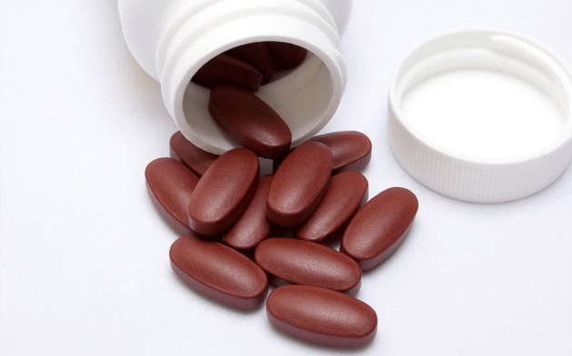

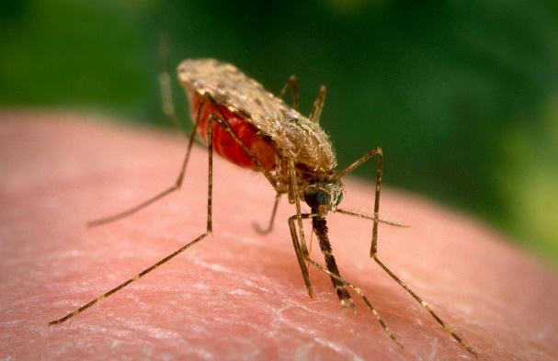
Anemia
Prevention and Treatment
Increase intake of iron rich food and fortified foods with iron (foods with added iron)
Iron supplementation (medication)
Increased intake of other vitamins such as vitamin A, folic acid and vitamin B12 (Megaloblastic anemia)
Control of parasitic infections

Slide 40

Zinc
Function
Part of enzymes involved in CHO, lipid, protein and nucleic acid metabolism
Necessary for growth
Helps in the production of enzymes
Helps building a healthy immune system
Maintains your senses of smell and taste
Vegetarians are at greater risk of deficiency
Symptoms include short stature
Deficiency

Slide 41

Iodine
Part of the thyroid hormones, which control the rate of cell metabolism
Function

Slide 42
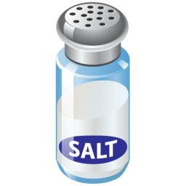
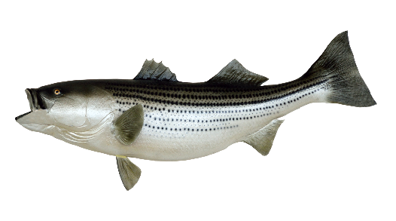
Iodine
Content of animal and plant foods depends on amount of iodine in the soil or water where they are grown
Best sources are iodized salts and sea foods
Sources
Iodized Salt
Seafood

Slide 43
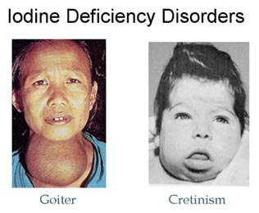
Iodine
Goiter: enlargement of the thyroid gland, weight gain, defect in regulation of body temperature
Cretinism: in children of iodine deficient mother: mental retardation, impaired physical development
Deficiency

Slide 44
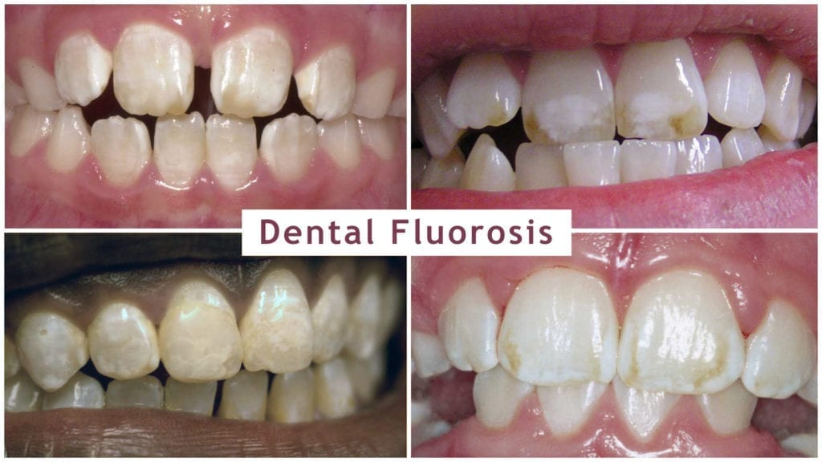
Fluoride
Present in Bones and Teeth
Make teeth resistant against cavities
Best sources are fluoridated water
Fluorosis
Increased incidence of dental cavities
Function
Sources
Deficiency

Slide 45

Water

Slide 46

Water
Water constitutes majority of body weight: 60% of an adult’s body weight.
The body needs more water per day than any other nutrient.
Water is found in: blood vessels, cells (and chemical structure of cells), tissues, organs.
Influenced by body composition: water makes up 75% of the weight of lean tissues and less than 25% of weight of fat.
Because of their proportion of lean tissues, the proportion of water is smaller in: Females, Obese people, Elderly.

Slide 47

Water in the Body
Carries nutrients and waste products
Maintains structure of large molecules
Participates in metabolic reactions
Serves as a solvent
Acts as a lubricant and cushion
Aids in regulation of body temperature
Maintains blood volume

Slide 48


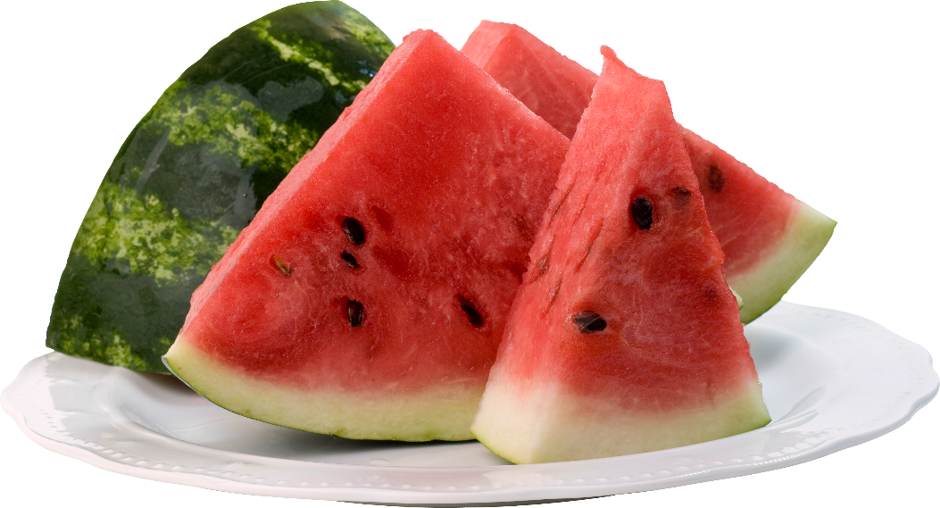
Water Sources
Water
Beverages
Foods

Slide 49

Recommended Water Intake
Needs vary depending on diet, activity, environment and humidity.
An average of 8-10 cups per day of water is recommended.
Your body also obtains some water from foods.
In warm weather, extra water is required.
People who are more prone to dehydration and need to drink more are the elderly and children.
Under normal conditions, adults need between 1 and 1.5 liters of water from all sources for each calorie spent in the day.

Slide 50

Information For Your Interest

Slide 51
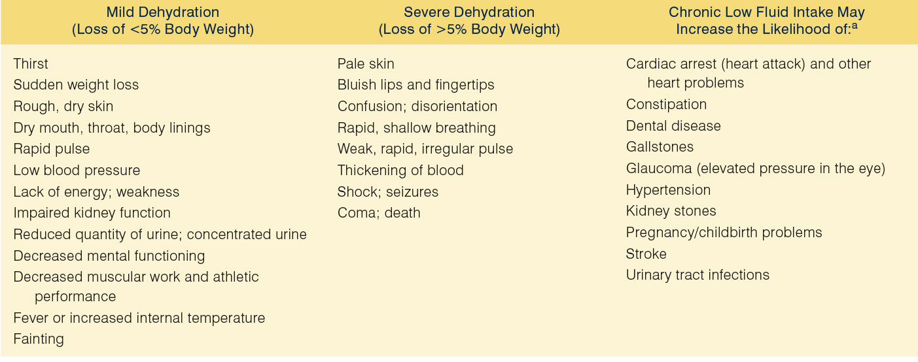
Effects of Mild and Severe Dehydration

